Slide 1

Strings
Prof. Dr. Alp KUT
Asst. Prof. Dr. Derya BİRANT

Slide 2
Outline
Characters
Special Characters
Strings
String Operations
Examples

Slide 3
Characters
Character data type is used to store one alphanumeric data, such as letters, numbers, spaces, symbols, and punctuation.
Examples: A B a b 1 2 ; ? # % ...

Slide 4
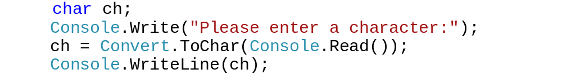
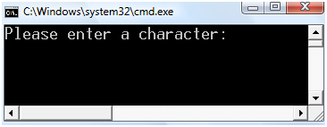
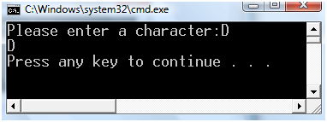
Characters in C#
The statement char ch; declares a single-byte variable named "ch" which holds one character.
Example:

Slide 5
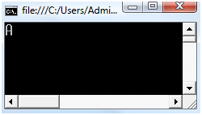

Characters in C#
The value of a char is assigned in single quote (ˈˈ) using the standard assignment operator (=) .
Example:

Slide 6
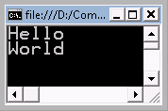
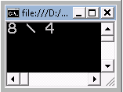
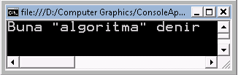
Special Characters in C#
Symbol | Character name
\' | Single quote
\" | Double quote
\\ | Backslash
\0 | Null
\a | Alert
\b | Backspace
\f | Form feed
\n | New line
\r | Carriage return
\t | Horizontal tab
\v | Vertical tab
Console.Write("Hello \n");
Console.Write("World");
Console.WriteLine("8 \\ 4");
Console.WriteLine("Buna \"algoritma\" denir");

Slide 7
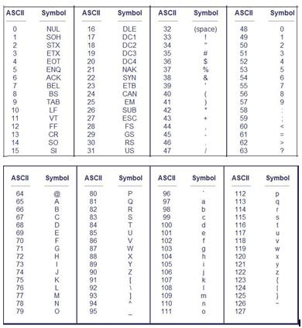

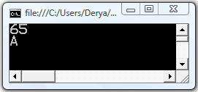
ASCII Character Codes

Slide 8
Strings
A string is an ordered sequence of characters.
Examples: Apartman Kurabiye
A string data type is a data type storing a sequence of data values, usually bytes, in which elements usually stand for characters.

Slide 9
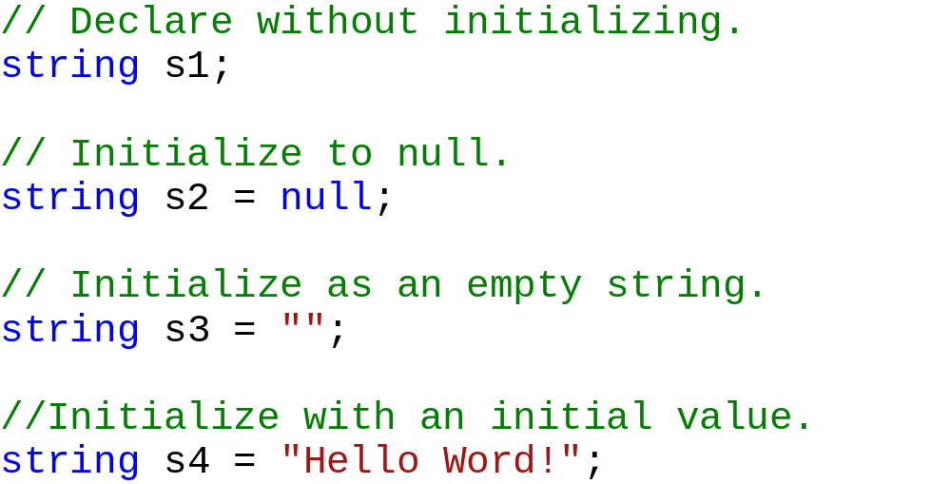
Strings in C#
A string variable can be declared in different ways:

Slide 10
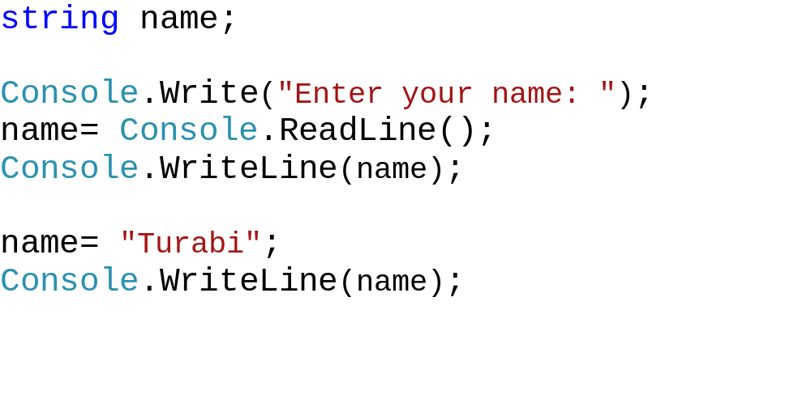
Strings in C#
The value of a string is assigned in double quotes (" ") using the standard assignment operator (=).
Example:

Slide 11
String Operations
Possible operations over strings:
Comparing
Appending
Inserting
Conversion
Copying
Formatting
Indexing
Joining
Splitting
Trimming
Removing
Replacing
Searching
...

Slide 12
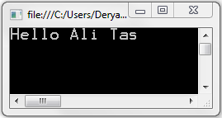
String Concatenate
String concatenation can be done in different ways
+ or += operators
String.Concat
Example:
string name = "Ali";
string surname = "Tas";
string str;
str = "Hello " + name + " " + surname;
Console.WriteLine(str);

Slide 13
String Concatenate
Example:
string name = "Turabi";
string surname = "Tas";
string str="";
str = String.Concat("Hello ", name, " ",surname);
Console.WriteLine(str);

Slide 14
Comparing Strings
There are several ways to compare strings for equality
Equals() member method
Equals() static method
== and != Operators
CompareTo()
  Returns 0 if equal, negative if less, positive if greater

Slide 15
Comparing Strings
string str1 = "hello";
string str2 = "mello";
if (str1.Equals(str2))
Console.WriteLine("Eşit");
else
Console.WriteLine("Eşit Değil");
if (str1 == str2)
Console.WriteLine("Eşit");
else
Console.WriteLine("Eşit Değil");
int result = str1.CompareTo(str2);
if (result == 0)
Console.WriteLine("Eşit");
else if (result > 0)
Console.WriteLine("Büyük");
else
Console.WriteLine("Küçük");
if (string.Equals(str1, str2))
Console.WriteLine("Eşit");
else
Console.WriteLine("Eşit Değil");

Slide 16
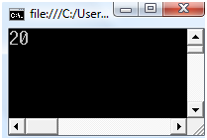
String Length
Returns the length of the string
Useful for loops
Example:
string str;
str = "Bugun hava cok guzel";
Console.WriteLine(str.Length);

Slide 17
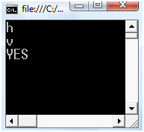
String Indexer
Retrieves any character in the string using a subscript
Example:
string str;
str = "Bugun hava cok guzel";
Console.WriteLine(str[6]);
Console.WriteLine(str[8]);
if (str[4]=='n')
Console.WriteLine("YES");

Slide 18
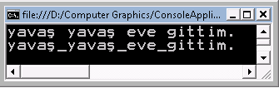
Replace
Replaces all occurrences of a specified string in this instance, with another specified string.
Replace(oldValue, newValue )
Example:
string str = "hızlı hızlı eve gittim.";
str = str.Replace("hızlı", "yavaş");
Console.WriteLine(str);
str = str.Replace(' ', '_');
Console.WriteLine(str);

Slide 19
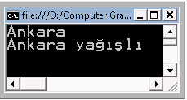
Substring
Retrieves a substring from this instance.
  The substring starts at a specified character position.
Substring(startIndex)
  The substring starts at a specified character position and has a specified length
Substring(startIndex, length)
Example:
string str = "İstanbul soğuk, Ankara yağışlı";
string str2;
str2 = str.Substring(16, 6);
Console.WriteLine(str2);
str2 = str.Substring(16);
Console.WriteLine(str2);

Slide 20
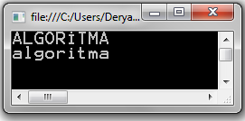
ToLower – ToUpper
ToLower : Returns a copy of the string converted to lowercase
ToUpper : Returns a copy of the string converted to uppercase
Example:
string str = "AlGoRitmA";
string output;
output = str.ToUpper();
Console.WriteLine(output);
output = str.ToLower();
Console.WriteLine(output);

Slide 21
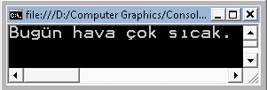
Insert
Inserts a specified instance of String at a specified index position in this instance
Insert into at any position; other characters are moved
Insert(startIndex, value )
Example:
string str = "Bugün hava sıcak.";
string output;
output = str.Insert(10, " çok");
Console.WriteLine(output);

Slide 22
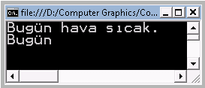
Remove
Deletes all the characters from this string beginning at a specified position and continuing through the last position.
Remove(startIndex)
Deletes a specified number of characters from this instance beginning at a specified position.
Remove(startIndex, count)
Example:
string str = "Bugün hava çok sıcak.";
string output;
output = str.Remove(10, 4);
Console.WriteLine(output);
output = str.Remove(5);
Console.WriteLine(output);

Slide 23
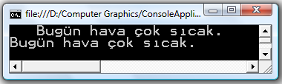
Trim
Removes all leading and trailing white-space characters from the current object
Example:
string str = " Bugün hava çok sıcak. ";
string output;
Console.WriteLine(str);
output = str.Trim();
Console.WriteLine(output);

Slide 24
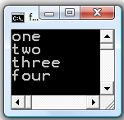
Split
Returns a string array that contains the substrings in this instance that are delimited by elements of a specified string.
Split( separator)
Example:
string str = "one;two;three;four";
string[] words = null;
words = str.Split(';');
for (int i = 0; i < words.Length; i++)
Console.WriteLine(words[i]);

Slide 25
Char/String Search
Finds the position of a char or string
IndexOf (The index of the first occurrence of a char or string)
IndexOfAny (The index of the first occurrence of any char in a
specified char array)
LastIndexOf (The index of the last occurrence of a char or string)
LastIndexOfAny (The index of the last occurrence of any char in a
specified char array)

Slide 26
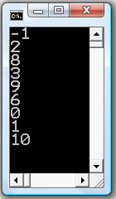
int index;
char[] SearchLetters = { '$', 'b', 'e' };
string letters = "abcdefabcdef";
index = letters.IndexOf('*');
Console.WriteLine(index);
index = letters.IndexOf('c');
Console.WriteLine(index);
index = letters.LastIndexOf('c');
Console.WriteLine(index);
index = letters.IndexOf("def");
Console.WriteLine(index);
index = letters.LastIndexOf("def");
Console.WriteLine(index);
index = letters.IndexOf('a', 3);
Console.WriteLine(index);
index = letters.LastIndexOf('a', 3);
Console.WriteLine(index);
index = letters.IndexOfAny(SearchLetters);
Console.WriteLine(index);
index = letters.LastIndexOfAny(SearchLetters);
Console.WriteLine(index);

Slide 27
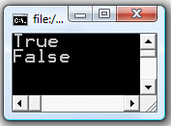
Contains
Returns a boolean value indicating whether the specified string occurs within another string
Contains( stringvalue )
Example:
string str1 = "En sevdiğim ders algoritma, çok zevkli";
string str2 = "algoritma";
bool b;
b = str1.Contains(str2);
Console.WriteLine(b);
b = str1.Contains("fizik");
Console.WriteLine(b);

Slide 28
Example
Write a program that finds a string is palindrome or not
ey edip adanada pide ye
anastas rulo iyi olur satsana
kalas yok kütük koy salak
string str = "MADAM";
bool flag = true;
for (int i = 0; i < (str.Length -1)/2; i++)
if (str.Substring(i, 1) != str.Substring(str.Length-i-1, 1))
flag = false;
if (flag)
Console.WriteLine("Palindrome");
else
Console.WriteLine("Palindrome degil");

Slide 29
Example
Write a program that finds “how many times letter ‘a’ appears in the string”
string str="Bugun hava çok güzel";
int counter = 0;
for (int i = 0; i < str.Length; i++)
if (str.Substring(i, 1) == "a")
counter++;
Console.WriteLine(counter);

Slide 30
Example
Write a program that finds the similarity percentage of two strings
Example: "AHMET SABRİ KESGİN“
"AHNET SAPRİ KESKİN“
18 characters, 3 characters are different
100 – ((3 / 18) * 100) % 83.3
string str1="AHMET SABRİ KESGİN";
string str2="AHNET SAPRİ KESKİN";
double counter = 0;
for (int i = 0; i < str1.Length; i++)
if (string.Equals(str1.Substring(i, 1), str2.Substring(i, 1)))
counter++;
Console.WriteLine((counter / str1.Length) * 100);

Slide 31
Example
Write a program that encrypts a string
Example: "Beni şifrele"
"Ehql#Tliuhoh"
string str="Beni şifrele";
string encrypted_str = "";
for (int i = 0; i < str.Length; i++)
encrypted_str = encrypted_str +Convert.ToChar(Convert.ToChar(str.Substring(i,1))+3);
Console.WriteLine(encrypted_str);

